Slide 1
Hypertension Disparities in Black Americans
Alysen Casaccio

Slide 2
Introduction
Identification and Treatment of Hypertension is Essential:
Significant contributor to heart attack, stroke, and other life-threatening issues.
No obvious symptoms
Most modifiable risk factor for cardiovascular disease
Significant differences for Non-Hispanic Black American males:
Diagnosed earlier in life
Experience 4-5x greater hypertension-related mortality
30% higher risk of stroke
50% higher risk of cardiovascular disease
4x higher risk of end stage renal disease (kidney failure)

Slide 3
Problem Statement
Are hypertension disparities in Black American males related to discrimination experiences in the United States?

Slide 4
Additional Background
Higher education and higher socioeconomic status is a not a protective health factor, for Black Americans –
Having a college degree is associated with higher odds of experiencing discrimination.
Higher socioeconomic status is not a measurable protective health factor.
1/3rd of Black Americans reported experiencing discrimination in clinical encounters.

Slide 5
Data Analysis
Downloaded and combined two data sets from the National Health Interview Survey:
1974 and 2019.
Variables Used:
Survey Year
Race
Gender
Informed You Have Hypertension
Taking a Hypertensive Medication
Time Since Last Doctor’s Visit.
Variables Normalized, but not Used:
Education Level, Income, Height, Weight, BMI, Comorbidity: Diabetes, Comorbidity: Stroke, Comorbidity: Cardiovascular Disease.

Slide 6
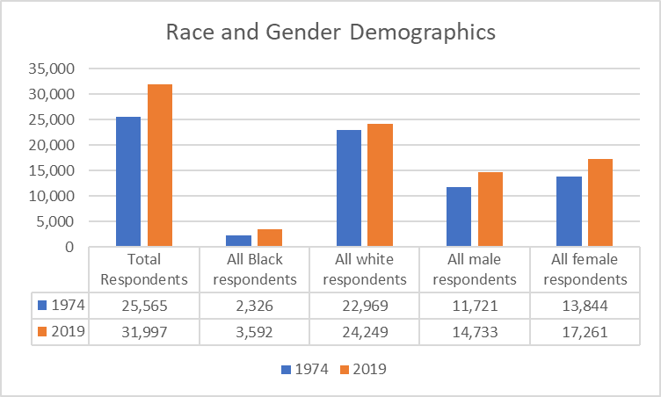
Demographic Representation
My focus population, Black males, appeared to be under-represented
1974 – 3% of respondents
2019 – 4% of respondents

Slide 7
Three Measures:
Hypertension Identification
Pharmaceutical Treatment
Hypertension Follow-Up

Slide 8
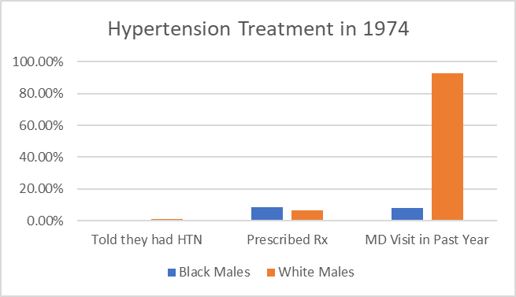
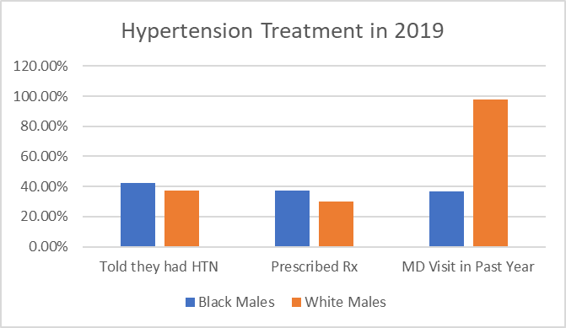
Identification, Pharmaceuticals, and Follow-Up: 1974 vs 2019

Slide 9
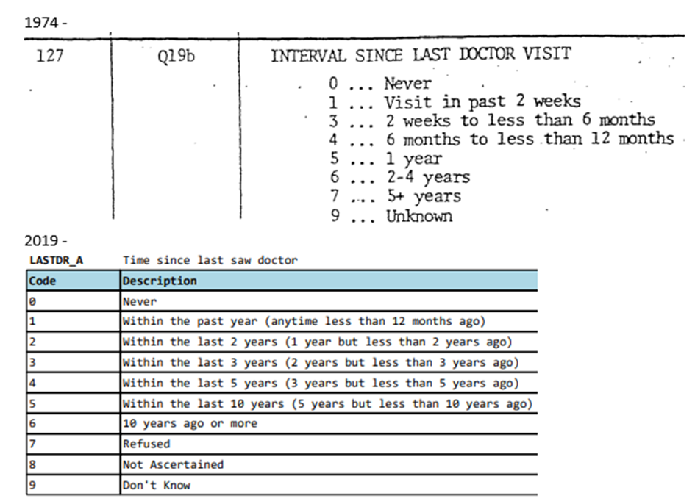
Assumptions
One data point utilized required normalization across the survey records because the available response options were significantly changed.
Final Mapping:
0 – Never
1 – Within the past year
Includes 1974 options: 1-4
2 – Within the past 2 years
Includes 1974: 6 and 2019: 2-4
3 – 5 years or greater
Includes 1974: 4 and 2019: 5-6
4 – Refused, Not Ascertained, or Unknown
Includes 1974: 9 and 2019: 7-9

Slide 10
Ethical Concerns
Outside of the Survey’s Intended Purpose
Siloed Solution Generation
Survey Modalities
The survey data is representative of live, in-person, or telephone survey processes.
These will always have some inherent bias on the part of the surveyors.
If a larger project was undertaken, I would recommend investigating deeper into the processes and methodologies used to obtain the survey responses.
These surveys are designed to represent the entire nation’s experiences and health markers.
We cannot assume a comprehensive survey, filtered and used to examine an under-represented minority population would have the same result as surveying the affected population directly with the purpose to better understand the root cause of the disparities.
Public health datasets are often used to identify opportunities for improvement and ideas for solutions.
The affected population must be engaged as key stakeholders in any proposed solution or the process itself creates ethical concerns.

Slide 11
Challenges
Results Communication
Too Much Data, Not Enough Meaning
Presenting persistent disparity information to clinicians and healthcare leaders can be challenging.
The data reveals patterns that show where treatment and access have decades of inequality across the system that still exist.
These patterns show the impact of the barriers which are built into our processes and institutions in ways that are invisible to those who aren’t living in the US as a minority group.
The data scientist must be able to mitigate and circumvent cultures of blame and defensiveness to reach actionable solutions in the conference rooms of hospitals and clinics, nationwide.
The inclination to include many variables, feeling that so many data points could have an impact on the results was challenging.
A great deal of time was spent analyzing, adjusting, and re-mapping data points that were never used because my first filters showed the strongest and clearest message in alignment with my problem statement.
Some examples of data normalized but not used:
Mathematical adjustment of income responses for inflation
Creation of a BMI calculator for the 1974 survey
Alignment of values to determine veteran status across both surveys

Slide 12
Conclusion
The healthcare industry has been aware of racial and ethnic disparities and underrepresentation for decades. We are at a time when many social and financial pressures are converging in a way that it may be finally possible to make positive changes to this long-lasting problem. Communication about the data and collaborating toward actionable solutions will be key.

Slide 13
Disease only treats humans equally when our social orders treat humans equally.
“
”
--John Green, “The Anthropocene Reviewed”

Slide 14
Thank you
Alysen Casaccio, RN-BC, BHA, CPHIMS
acasaccio@bellevue.edu

